Slide 1
Equivariant Manifold Neural ODEs and Differential Invariants
arXiv: 2401.14131[cs.LG]
Emma Andersdotter

Slide 2
The Project
Fredrik Ohlsson (my supervisor) and I finished writing this paper at the end of January, this year.
The project is within geometric deep learning.
We consider equivariant manifold neural ODEs.
We show that equivariant manifold neural ODEs are universal approximators using augmentation.
We consider the induced action on different fields on our data manifold.

Slide 3
Outline
Neural Ordinary Differential Equations
Equivariance
Equivariant Manifold Neural ODEs
Universality
Equivariant Fields and Densities
Background
Main contributions

Slide 4
Neural Ordinary Differential Equations

Slide 5
Neural ODEs
$$u_{t}$$
Main idea:
Models such as ResNets have the form
$$u_{t+1}=u_{t}+f\left(u_{t},θ_{t}\right).$$
Looks like the Euler method!
More layers and smaller steps between them gives, in the limit,
$$\frac{du(t)}{dt}=f\left(u\left(t\right),t,θ\right).$$
(Chen et al., 2018)
$$f(u_{t},θ_{t})$$
$$u_{t}+f(u_{t},θ_{t})$$
2

Slide 6
Neural ODEs in Practice
The function $f$ is parametrised by a neural network.
$u(0)$ is our input. The solution $u(1)$ is our output.
$u(1)$ is computed using some ODE solver. The loss is computed by comparing $u(1)$ to the ”actual” output. (Chen et al., 2018)
The loss function is minimized using the adjoint sensitivity method. (Pontryagin et al., 1962)
Neural ODE:
$$\frac{du(t)}{dt}=f\left(u\left(t\right),t,θ\right).$$

Slide 7
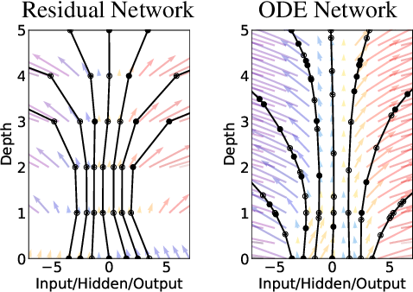
Ricky T. Q. Chen, Yulia Rubanova, Jesse Bettencourt, and David K. Duvenaud. Neural ordinary differential equations. Advances in Neural Information Processing Systems, 31, 2018.

Slide 8
Neural Manifold ODEs
Where does our data live?
In the original article, $ℝ^{n}$, but it could also be on an arbitrary manifold $M$. (Lou et. al., 2020; Falorsi et al., 2020)
Our ODE is generalized to
$$\frac{du}{dt}=φ_{u(t)}, u\left(0\right)=p,$$
where $u$ is a curve and $φ$ is a vector field on $M$. $φ_{u(t)}∈T_{u(t)}M$.
The ODE is solved by a flow $Φ:ℝ×M→M$ such that
$${\left.\frac{d}{dt}Φ\left(t,q\right)\right|}_{t=0}=φ_{q}.$$

Slide 9
Equivariance

Slide 10
Equivariance
$90°$ rotation
A network is equivariant under an action (e.g. rotation or translation) if acting on the input before applying the network is the same as acting on the output after applying the network.
Scaling
Scaling
$90°$ rotation

Slide 11
Let’s look at this mathematically
Y
Let’s $f:X→Y$ be a map between two $G$-spaces $X$ and $Y$.
Let $g∈G$.
Equivariance means $f\left(g∙x\right)=g∙f(x)$ for all $g∈G$.
For a network $f$, think of $X$ as the input space and $Y$ as the output space.
g
f
f
g
X

Slide 12
Invariance
Y
f
A special case of equivariance is invariance. Here $f\left(g∙x\right)=f(x)$.
f
g
X

Slide 13
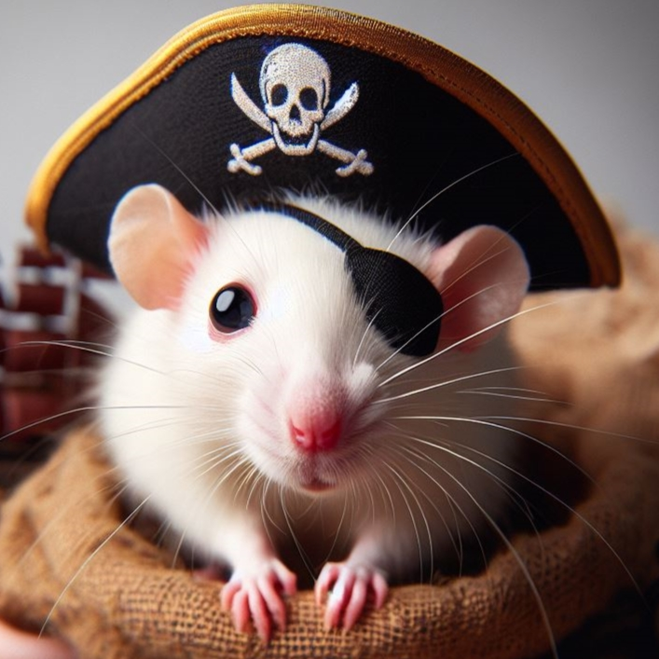
Example: Rotational Invariance
A neural network is invariant under rotation if we get the same output even if we rotate the input.
$π$-rat
Network
Photo of rat was generated using Copilot.

Slide 14
Equivariant Manifold Neural ODEs

Slide 15
Geometric Framework
We want to work with NODEs on arbitrary path-connected smooth manifolds $M$.
Our ODE is generalized to
$$\frac{du}{dt}=φ_{u(t)}, u\left(0\right)=p,$$
where $u$ is a curve and $φ$ is a vector field on $M$. $φ_{u(t)}∈T_{u(t)}M$.
The ODE is solved by a flow $Φ:ℝ×M→M$ such that
$${\left.\frac{d}{dt}Φ\left(t,q\right)\right|}_{t=0}=φ_{q}.$$

Slide 16
Group action on $M$ and equivariance
$$v$$
$G$ is a symmetry group acting on $M$.
Denote the left action by $L_{g}.$
${{(L}_{g})}_{∗}$ is the push-forward of $L_{g}.$
$${{(L}_{g})}_{∗}v$$
$$L_{g}$$
$$p$$
$$L_{g}p$$

Slide 17
Group action on $M$ and equivariance
The vector field $φ$ is equivariant if $φ_{L_{g}p}={{{(L}_{g})}_{∗}φ}_{p}$ for all $p$ in $M$ and $g$ in $G$.
The solution $Φ$ is equivariant if $L_{g}Φ\left(t,p\right)=Φ\left(t,L_{g}p\right)$.
A diffeomorphism $h\left(u\left(0\right)\right)=u(1)$ is equivariant if $L_{g}h\left(p\right)=h(L_{g}p)$.
Can show that these are equivalent. (Katsman et al., 2021; Köhler et al., 2020; EA and Ohlsson)
$$h$$
$$u\left(1\right)$$
$$φ_{u(t)}$$
$$Φ(t,p)$$
$$p=u(0)$$

Slide 18
Differential Invariants and Equivariant NODEs
Neural ODE:
$$\frac{du(t)}{dt}=f\left(u\left(t\right),t,θ\right).$$
How do we parametrise an equivariant NODE?
$k$-th order jet space $J^{k}$: ”The original space and the derivatives up to order $k$.”
A $k$-th order differential invariant for a group $G$ is a function $I:J^{k}→ℝ$ which is invariant under the group action of $G$.

Slide 19
Differential Invariants and Equivariant NODEs
Let $I_{1},…,I_{μ_{k}}$ be a complete set of functionally independent differential invariants of order $k$. Then, the most general ODE of order $k$ for which $G$ is a symmetry group is (locally) on the form
$$F\left(I_{1},…,I_{μ_{k}}\right)=0.$$
for an arbitrary function $F:ℝ^{μ_{k}}→ℝ^{n}$. (Olver, 1993)
An equivariant neural ODE can be parametrized by a neural network $φ\left(I_{1},…,I_{k};θ\right)=0$ using differential invariants $I_{1},…,I_{k}$.
Neural ODE:
$$\frac{du(t)}{dt}=f\left(u\left(t\right),t,θ\right).$$

Slide 20
Example
Suppose that we are on $ℝ^{2}$ and we want our neural ODE to be rotationally equivariant.
We find out that this has $t$, $r$, $\dot{r}$ and $\dot{θ}$ as its first order differential invariants.
By our previous result, the most general first order ODE is of the form
$$F\left(t,r,\dot{r},\dot{θ}\right)=0.$$
This can, equivalently, be written as
$$\left\{\begin{aligned}\dot{r}=H(t,r) \\ \dot{θ}=G(t,r)\end{aligned}\right.$$
$$r(t)$$
$$θ(t)$$

Slide 21
Example
This can, equivalently, be written as
$$\left\{\begin{aligned}\dot{r}=H(t,r) \\ \dot{θ}=G(t,r)\end{aligned}\right.$$
Let $u\left(t\right)=(r\left(t\right),θ\left(t\right))$ and $φ\left(t,r\right)=(H\left(t,r\right),G\left(t,r\right))$. Then
$$\frac{du}{dt}=φ\left(t,r\right).$$
Thus, the right hand side of our ODE is, in polar coordinates, a function depending on $t$ and $r$.
$$r(t)$$
$$θ(t)$$

Slide 22
Universality

Slide 23
Universality
Can an NODE learn any diffeomorphism $h:M→M$?
Nope. ☹
For example, consider the map $h:ℝ→ℝ$ with $h\left(−1\right)=1$ and $h\left(1\right)=−1.$
”Best approximation”:
1
$$h\left(−1\right)$$
1
$$h\left(−1\right)$$
Time
Time
-1
$$h\left(1\right)$$
-1
$$h\left(1\right)$$

Slide 24
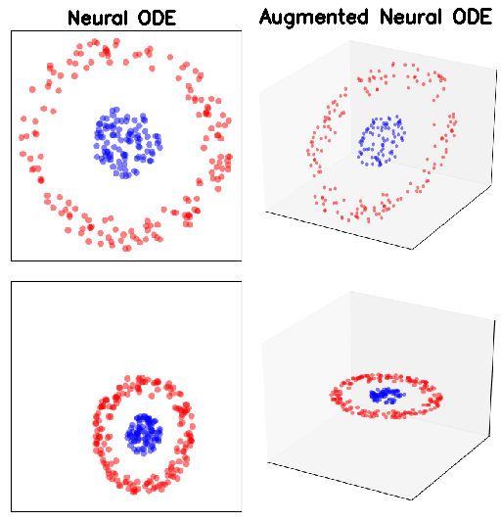
Augmentation
Issue: the trajectories of ODE solutions cannot intersect.
Solved by aumentation, i.e., adding enough extra dimensions so that the solution curves do not intersect. (Dupont et al., 2019)
Animation from: GitHub - EmilienDupont/augmented-neural-odes: Pytorch implementation of Augmented Neural ODEs :sunflower:

Slide 25
Augmentation
Suppose $u\left(t\right)∈ℝ^{p}$ in
$$\frac{du(t)}{dt}=f\left(u\left(t\right),t,θ\right).$$
The space on which the ODE is solved can be augmented from $ℝ^{p}$ to $ℝ^{p+q}$ by letting ${a\left(t\right)∈ℝ}^{q}$ and
$$\frac{d}{dt}\left[u\left(t\right),a(t)\right]=f\left(\left[u\left(t\right),a(t)\right],t,θ\right).$$
(Dupont et al., 2019)
Any diffeomorphism $h:ℝ^{p}→ℝ^{p}$ can be approximated by an augmented neural ODE on $ℝ^{2p}$. (Zhang et al., 2020)

Slide 26
Main Idea
Let $h$ be a diffeomorphism on a path-connected manifold $M$.
Suppose that curves $p↦h(p)$ and $q↦h\left(q\right)$ must intersect at some point.
Intersection at a time $t$ means $γ_{p}\left(t\right)=γ_{q}\left(t\right)…$
…but $γ_{p}′\left(t\right)≠γ_{q}′(t)$.
If $Γ_{p}=\left[γ_{p},\frac{d}{dt}γ_{p}\right]$ and $Γ_{q}=\left[γ_{q},\frac{d}{dt}γ_{q}\right]$, the curves $Γ_{p}$ and $Γ_{q}$ don’t intersect!
$γ_{q}$’
p
$$γ_{p}$$
h(q)
$$γ_{q}$$
$γ_{p}$’
q
h(p)

Slide 27
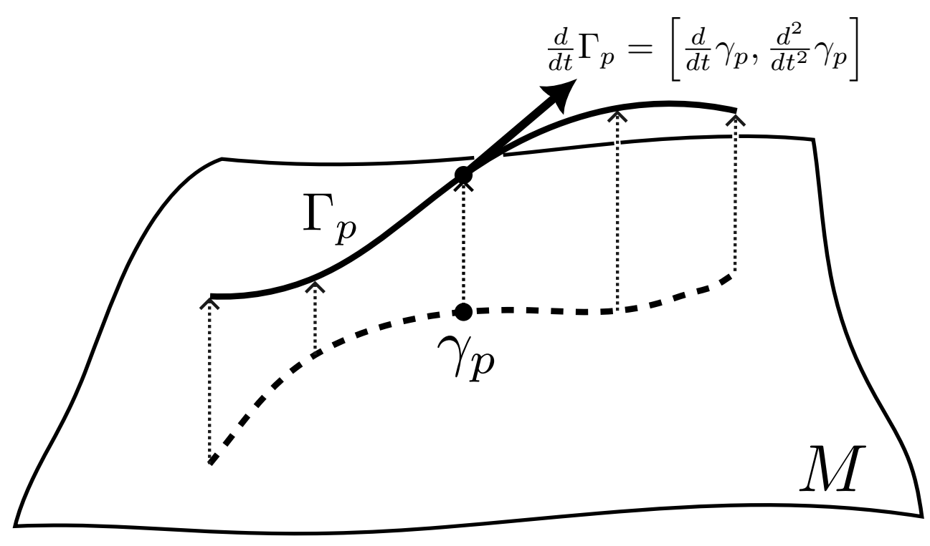
The Lift
If $γ_{p}$is a curve, then $Γ_{p}=\left[γ_{p},\frac{d}{dt}γ_{p}\right]$.
The diffeomorphism $h$ can be embedded in a flow on the tangent bundle $TM$ thanks to the lift.

Slide 28
Augmented Manifold Neural ODEs
$$T_{p}M$$
NODEs augented to $TM$ are universial approximators of diffeomorphisms $h:M→M$.
How do we construct this?
For $u(t)∈M$, let $U\left(t\right)=\left[u\left(t\right),\dot{u}(t)\right]$ and let $φ=\left[χ,ψ\right]$ be a vector field on $TM$ such that
$$\frac{d}{dt}U\left(t\right)=φ_{U\left(t\right).}$$
Require $χ\left(u,\dot{u}\right)=\dot{u}$.
$$(p,v)$$
$$v$$
$$π$$
$$M$$
$$TM$$
$$p$$

Slide 29
Augmented Manifold Neural ODEs
$$T_{p}M$$
$$(p,v)$$
The resulting augmented NODE is equivalent to the second order ODE $\ddot{u}\left(t\right)=ψ(u,\dot{u})$ on $M$.
The diffeomorphism $h$ where $p=u(0)$, $h\left(p\right)=u\left(1\right)$ is given by $h(p)=πU\left(1\right)$.
$$v$$
$$π$$
$$M$$
$$TM$$
$$p$$

Slide 30
Equivariance
Suppose that $h$ is equivariant, i.e., $L_{g}h\left(p\right)=h\left(L_{g}p\right).$ Can this be approximated by an equivariant augmented manifold neural ODE?
Yep! ☺
If $γ_{p}$ is a curve such that $γ_{p}\left(0\right)=p$ and $γ_{p}\left(1\right)=h(p)$, we can construct a flow $Φ:ℝ×TM→TM$ via $Φ\left(t,\left[p, {\dot{γ}}_{p}(0)\right]\right)=\left[γ_{p}\left(t\right),{\dot{γ}}_{p}(t)\right].$
If we define $γ_{L_{g}p}=L_{g}γ_{p}$, one can show that the flow $Φ$ is equivariant.
h(p)
$${\dot{γ}}_{p}(0)$$
$$γ_{p}$$
p

Slide 31
Example
Let’s go back to the case or rotational equivariance on the plane $ℝ^{2}$. $u\left(t\right)=(r\left(t\right),θ\left(t\right))$ is augmented to $U\left(t\right)=\left[u(t),\dot{u}(t)\right].$
We find out that this has $t$, $r$, $\dot{r}$, $\dot{θ}$, $\ddot{r}$ and $\ddot{θ}$ as its second order differential invariants.
By our previous result, the most general second order ODE is of the form
$$F\left(t,r,\dot{r},\dot{θ},\ddot{r}\text{, }\ddot{θ}\right)=0.$$

Slide 32
Example
This can, equivalently, be written as
$$\left\{\begin{aligned}\ddot{r}=H(t,r,\dot{r},\dot{θ}) \\ \ddot{θ}=G(t,r,\dot{r},\dot{θ})\end{aligned}\right.$$
Let $φ(t,r,\dot{r},\dot{θ)}=(H(t,r,\dot{r},\dot{θ}),G(t,r,\dot{r},\dot{θ}))$. Then
$$\frac{dU}{dt}=\left[\dot{u}\left(t\right),φ(t,r,\dot{r},\dot{θ)}\right].$$

Slide 33
Equivariant Fields and Densities

Slide 34
Continuous Normalizing Flows
A normalizing flow is a transformation of a simple probability distribution (e.g. standard normal) into a more complex distribution by a sequence of diffeomorphisms. (Chen et al., 2018)
Figure from Normalizing Flow – TikZ.net.

Slide 35
Continuous Normalizing Flows
The diffeomorphisms $f_{θ}:ℝ^{n}→ℝ^{n}$ transform samples $z$ with density $ρ$ into transformed samples $f_{θ}\left(z\right)$ with density $ρ_{f_{θ}}$. $ρ_{f_{θ}}$is obtained via change of variables:
$$ρ_{f_{θ}}\left(x\right)=ρ\left(f_{θ}^{−1}\left(x\right)\right)\det{\frac{∂f_{θ}^{−1}\left(x\right)}{∂x}}$$
Also called the "pushforward".
As with ResNets, the iterative updates of a normalizing flow can be seen as a discretization of an ordinary differential equation (Chen et al., 2018).

Slide 36
Equivariant Continuous Normalizing Flows
A normalizing flow is a transformation of a simple probability distribution (e.g. standard normal) into a more complex distribution by a sequence of diffeomorphisms.
Continuous normalizing flows are the neural ODE versions of normalizing flows.
Provided that the diffeomorphisms are equivariant, the prior and target densities will share the same symmetries. (Köhler et al., 2020)

Slide 37
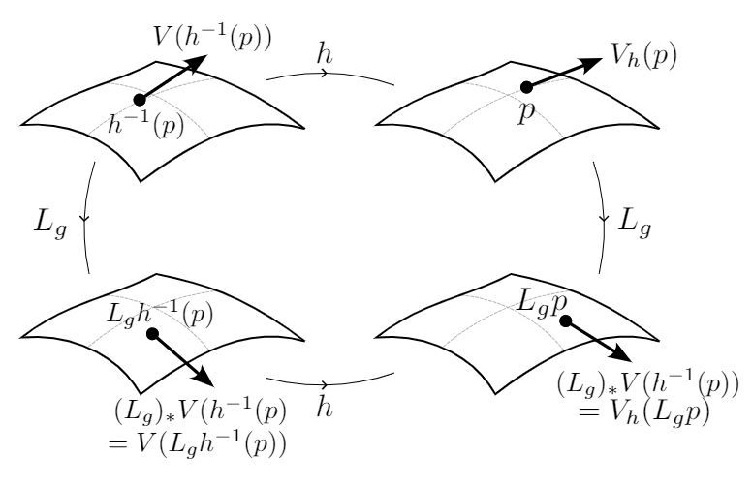
Equivariant Fields and Densities
We also considered the induced action of $G$ on different fields on $M$ and showed how it can be used to generalise previous work on, e.g., continuous normalizing flows, to equivariant models in any geometry.

Slide 38
Thank you for listening!

